Slide 1

Project Report
INTRODUCTION
1.1 Overview
Survey app is a sample project that demonstrates how to use the Android Compose UI toolkit to build a UI. The app simulates a interface, allowing the user to answer the survey
1.2 Purpose
Survey apps are applications that enable people to take surveys on their smartphone or tablet, even when the device is not connected to the internet. They are used to collect feedback, design, send and analyze surveys.

Slide 2
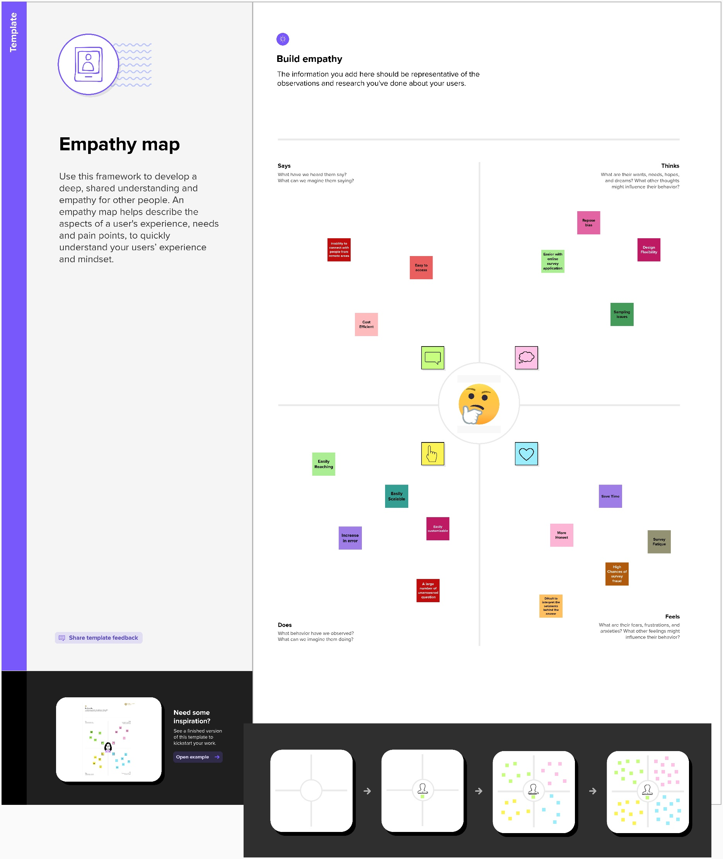
Problem Definition & Design Thinking
2.1 Empathy Map

Slide 3
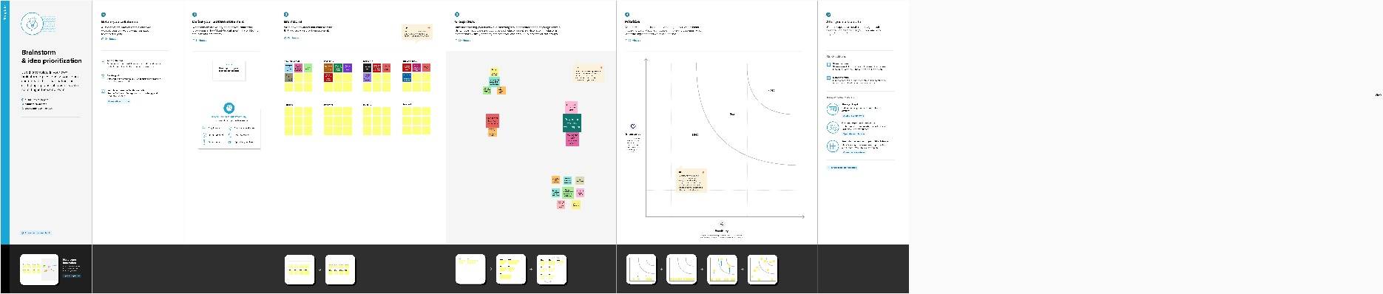
2.2 Ideation & Brainstorming Map

Slide 4
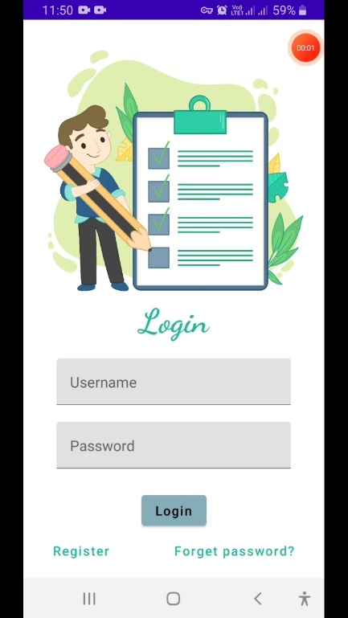
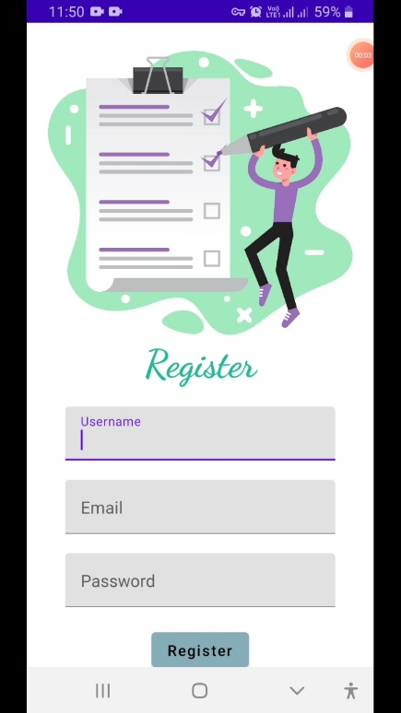
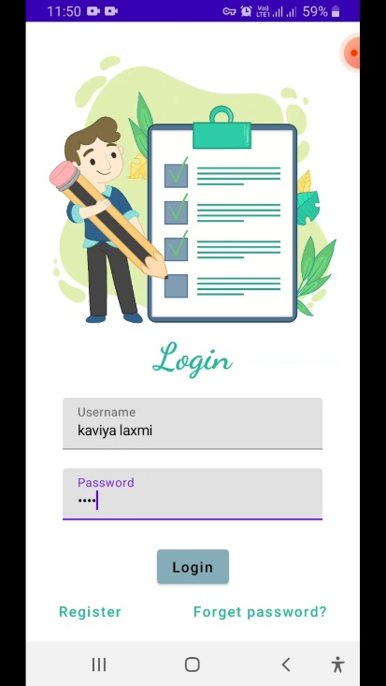
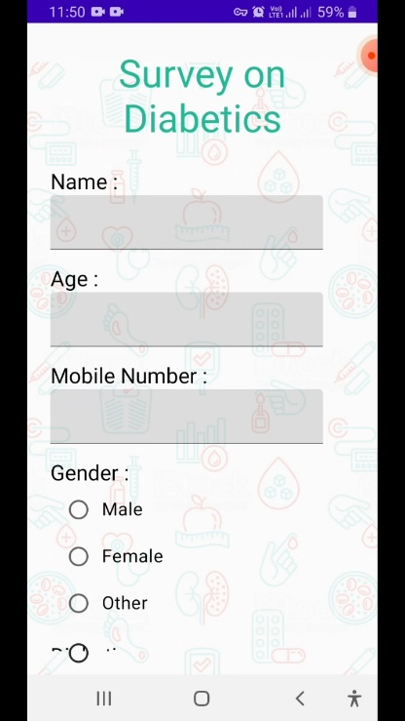
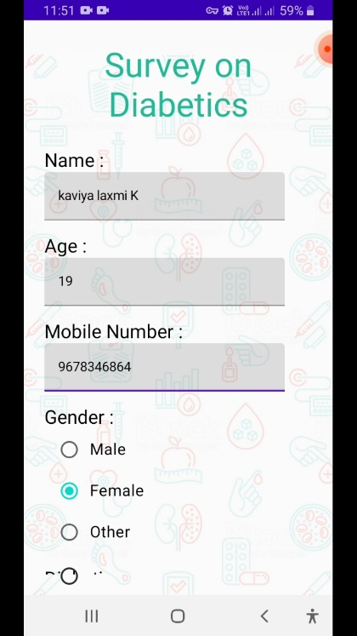
3 RESULT Output

Slide 5
4 ADVANTAGES & DISADVANTAGES
Advantages
Relatively easy to administer.
Can be developed in less time (compared to other data-collection methods)
Cost-effective, but cost depends on survey mode.
Can be administered remotely via online, mobile devices, mail, email, kiosk, or telephone.
Conducted remotely can reduce or prevent geographical dependence.
Disadvantages
Inflexible Design. The survey that was used by the researcher from the very beginning, as well as the method of administering it, cannot be changed all throughout the process of data gathering.
Not Ideal for Controversial Issues.
Possible Inappropriateness of Questions.

Slide 6
5 APPLICATIONS
High Representativeness. Surveys provide a high level of general capability in representing a large population. ...
Convenient Data Gathering.
Good Statistical Significance.
Little or No Observer Subjectivity.
There are many types of survey apps and everyone has its own format, design, and functions.
6 CONCLUSION
The Survey app provides a better and more flexible chat system.
Developed with the latest technology in the way of providing a reliable system.
The main advantage of the system is data gathering, real-world communication, observation, predictions, etc.

Slide 7
7 FUTURE SCOPE
developments are moving into an entirely new realm of near-complete automation
The majority of bots are being used today to provide answers to simple and quick questions
Survey apps are great at answering simple or even complex
The activities and items covered by the survey or inspection
Survey apps are applications that enable people to take surveys on their smartphone or tablet, even when the device is not connected to the internet
8 APPENDIX
Source Code
Visit: https://github.com/kaviyalaxmi/Compose-Input-A-Demonstration-of-Text-Input-and-Validation-with-Android-Compose (github.com)

